Slide 1
Hotel Aggregator Insights
Power BI Analysis
Presenter: Rakib Hasan Rahad
Contact Information: rahadrakib4@gmail.com
Dhaka, Bangladesh

Slide 2
Table of Contents
Problem Statement
Dataset Description
Key Areas of Analysis
Data Cleaning and Transformation
Data Analysis & Visualization in Power BI
Findings
Conclusion & Recommendations

Slide 3
Problem Statement
Challenge: Understand what makes listings successful to improve overall quality and competitiveness.
Data: Rich dataset with details about listings, hosts, reviews, and availability.
Goal: Analyze data using Power BI to uncover trends and factors influencing listing performance.

Slide 4
Dataset Description
Total Listings: 23,185 with 75 unique columns/attributes.
Data Points: Listings, hosts, reviews, availability.
Example columns:
id: Unique identifier for each listing.
listing_url: URL of the listing.
last_scraped: Date of the last data scrape.
name: Name of the listing.
description: Description of the listing.
host_id: Unique identifier for the host.
(and many more)

Slide 5
Key Areas of Analysis
Geographical Insights
Pricing and Availability
Host Performance
Review Scores and Guest Satisfaction
Property Type and Room Analysis

Slide 6
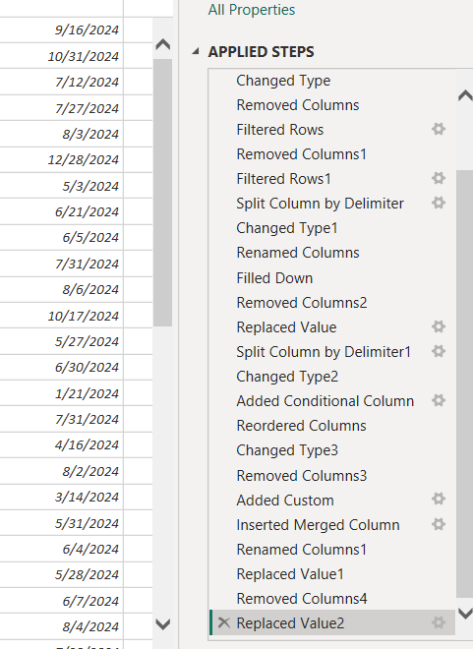
Data Cleaning and Transformation
Tools: Power Query Editor in Power BI.
Steps:
Remove irrelevant columns.
Handle missing values.
Ensure data consistency by addressing case sensitivity.
Outcome: A streamlined and clean dataset ready for analysis.

Slide 7
Data Analysis and Measures Creation
Techniques: DAX Functions & Measures in Power BI.
Metrics:
Total listings
Total hosts
Available listings
Findings: Insights into host performance and listing distributio

Slide 8
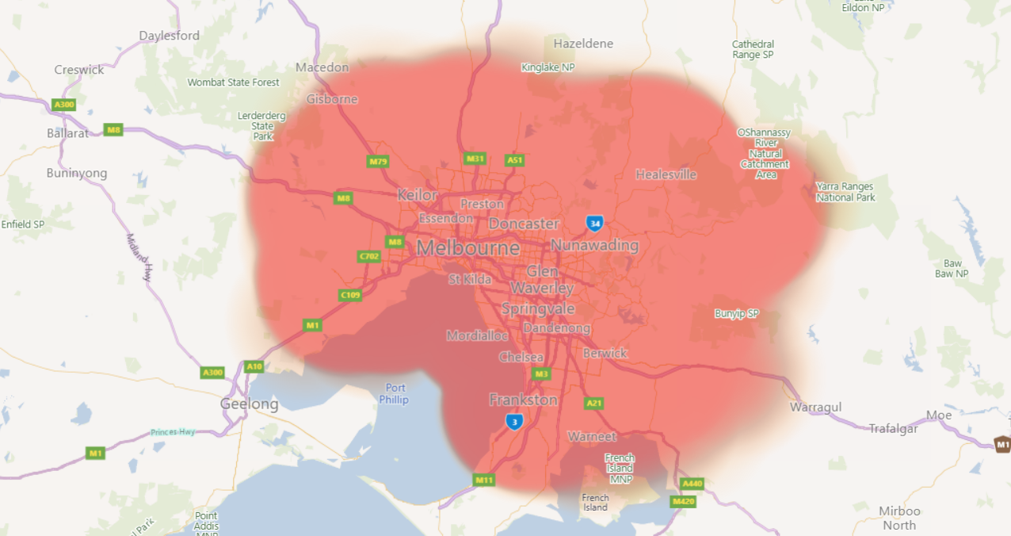
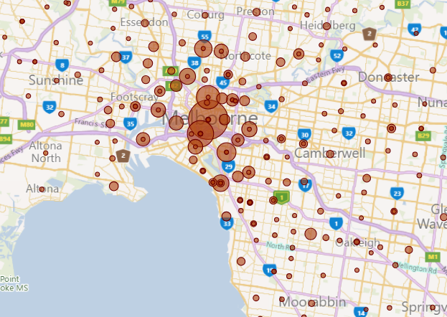
Geographical Insights
Popular Neighborhoods: Melbourne, Australia (31% listings), Port Phillip (11%).
Host Concentration: High in Newton/Enmore Neighborhood.
Geographical distribution with latitudde and longitude
distribution of listings on a map to identify popular neighborhoods.

Slide 9
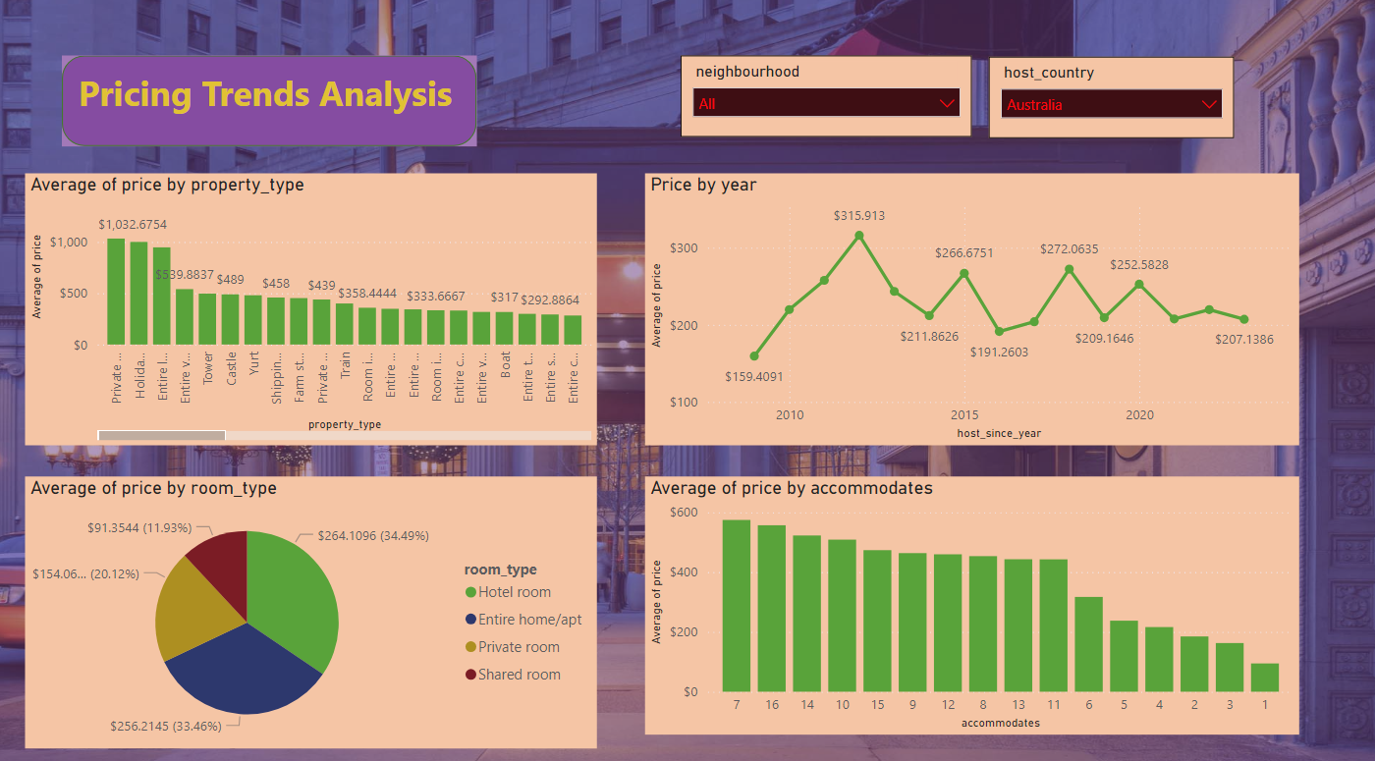
Pricing and Availability Analysis
Pricing Trends: Highest for Casa Particular property (Avg Price $9652.50).
Room Type Best Sellers: Entire home/apt ($261.61).
Availability Patterns: Highest in 2016.

Slide 10
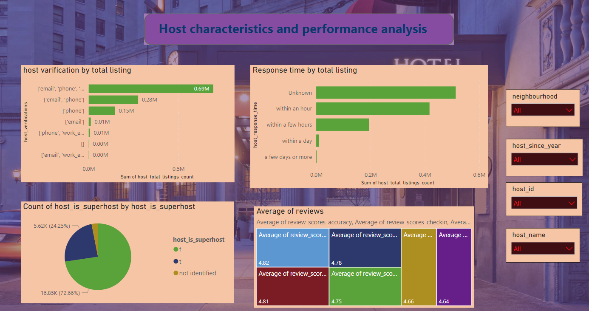
Host Performance & Review Scores and Guest Satisfaction Impact
Superhost Impact: 72.6% votes indicate no significant influence on listing performance.
Response Time and Verification: Positive effects on results and performance.
Higher response & acceptance rates lead to higher review scores (up to 5 stars).
Areas for Improvement: Cleanliness scored the lowest at 4.66.

Slide 11
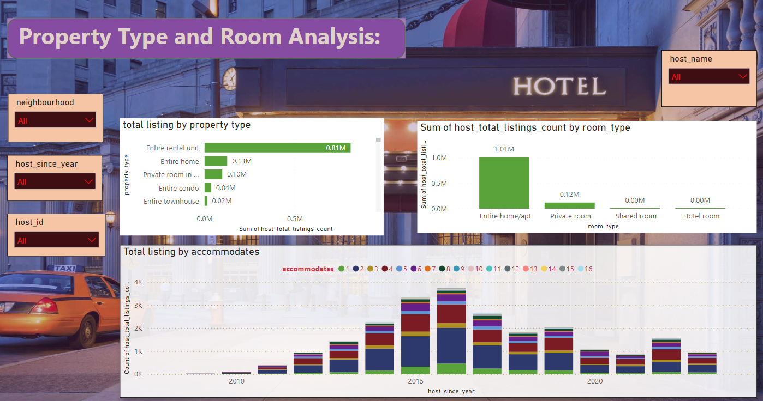
Property Type and Room Analysis
Property Distribution: Most prevalent is Entire Rental Unit (42.5% listings).
Room Type Trends: Entire home/apt followed by Private room.
Popular Listings: Accommodate 2 guests.

Slide 12
Recommendations
Targeted Listings: Optimize based on popular neighborhoods and property/room trends.
Pricing Strategies: Consider property type, room capacity, and peak seasons.
Host Support: Encourage faster response times and increased verification methods.
Guest Feedback Integration: Use reviews to suggest improvements.
Data Completeness: Ensure completeness in data scraping.

Slide 13
Conclusion
Summary: Data analysis with Power BI provided insights into factors influencing listing performance.
Benefits: Empower hosts to optimize listings and attract more bookings.
Goal: Enhance overall listing quality and competitiveness.

Slide 14
Thank You

